Slide 1
DNS over CHORD
Mitesh Kumar Savita - 110899145
Shikhar Sharma - 110739968

Slide 2
Background
Currently, we use hierarchically structured servers to serve DNS data.
We plan to explore an alternate way to serve DNS requests over Chord.
To be fair, we have implemented Hierarchical DNS resolver and Chord DNS resolver using DistAlgo.
We conducted multiple experiments on the performance of these two implementations.

Slide 3
Important files
master.da – This program reads from the config files and runs the experiments.
client.da – This program takes input from master.da program and runs individual queries on Chord and Hierarchical DNS.
hierarichalDNS.da – This program is our hierarchical dns resolver. It takes in queries and returns the result.
chordDNS.da – This program is the chord based DNS resolver. It has multiple nodes depending on the config file. This program takes in a query and resolves it using chord algorithms.
Github Repo : https://github.com/sharma-shikhar/CSE534-Final-Project

Slide 4
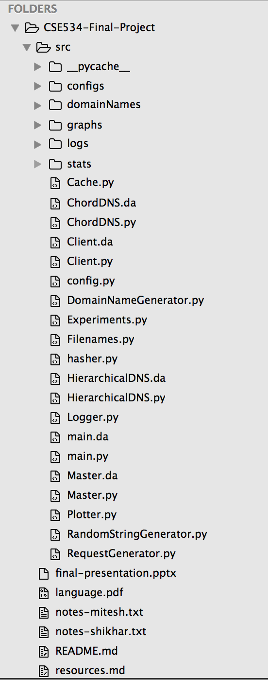
Folder structure

Slide 5
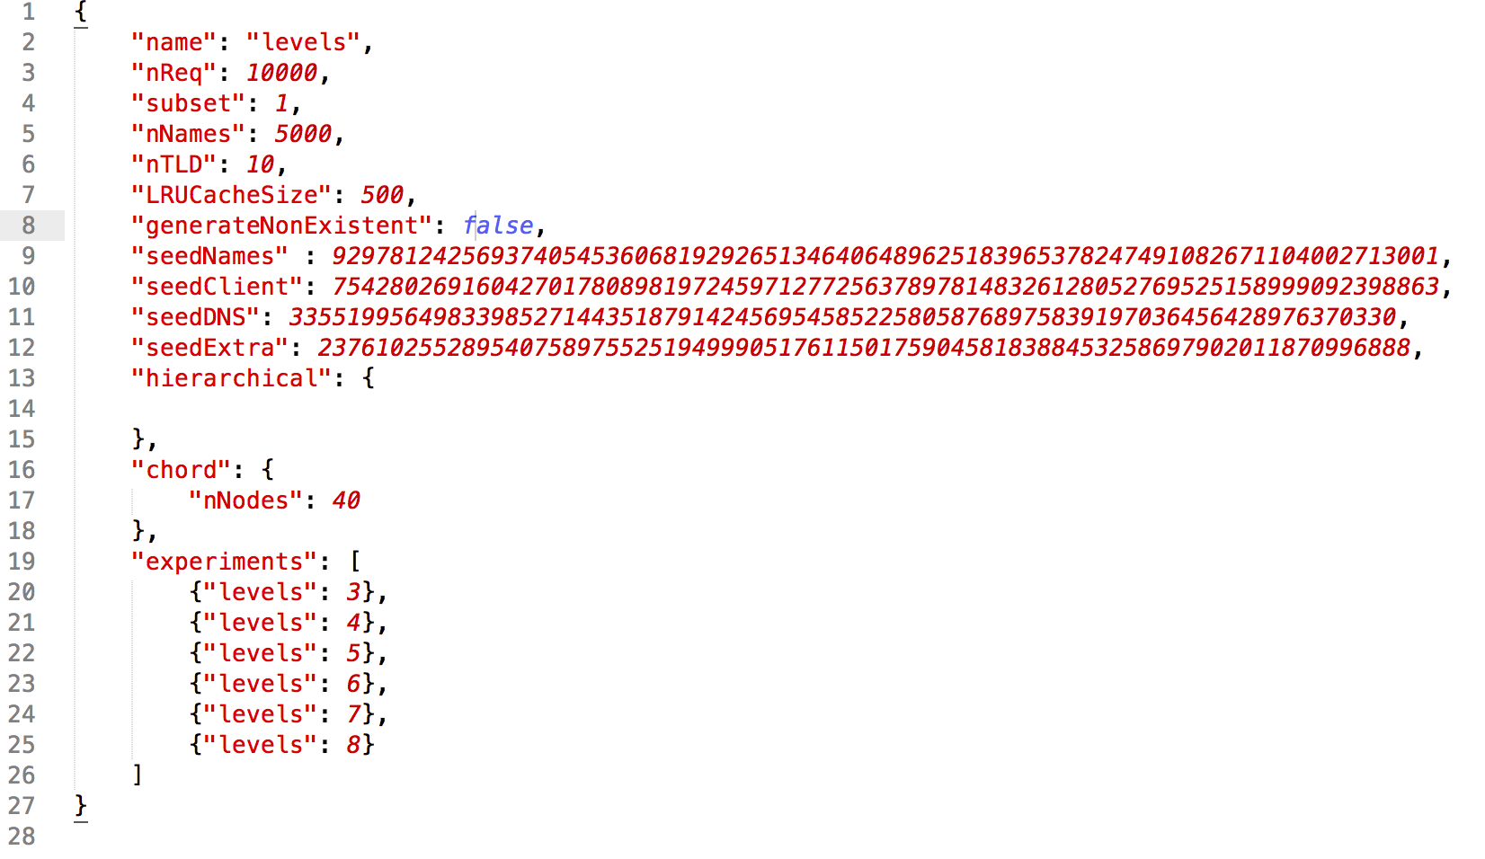
Configuration files

Slide 6
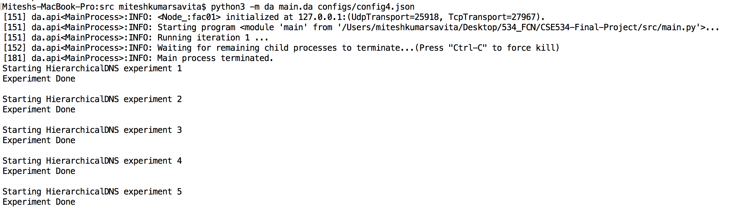
Experiments running

Slide 7
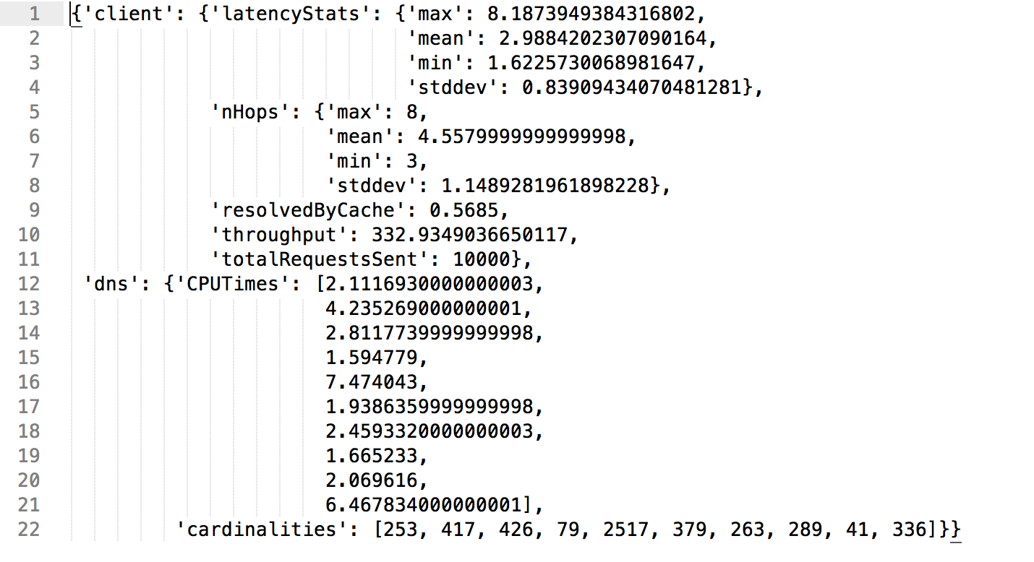
Stats files

Slide 8
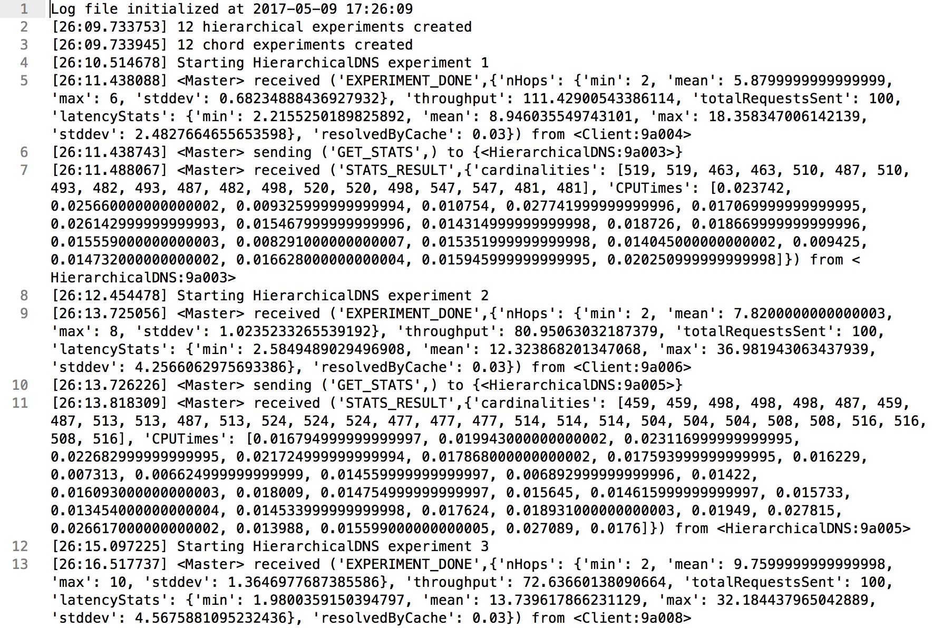
Master log file

Slide 9
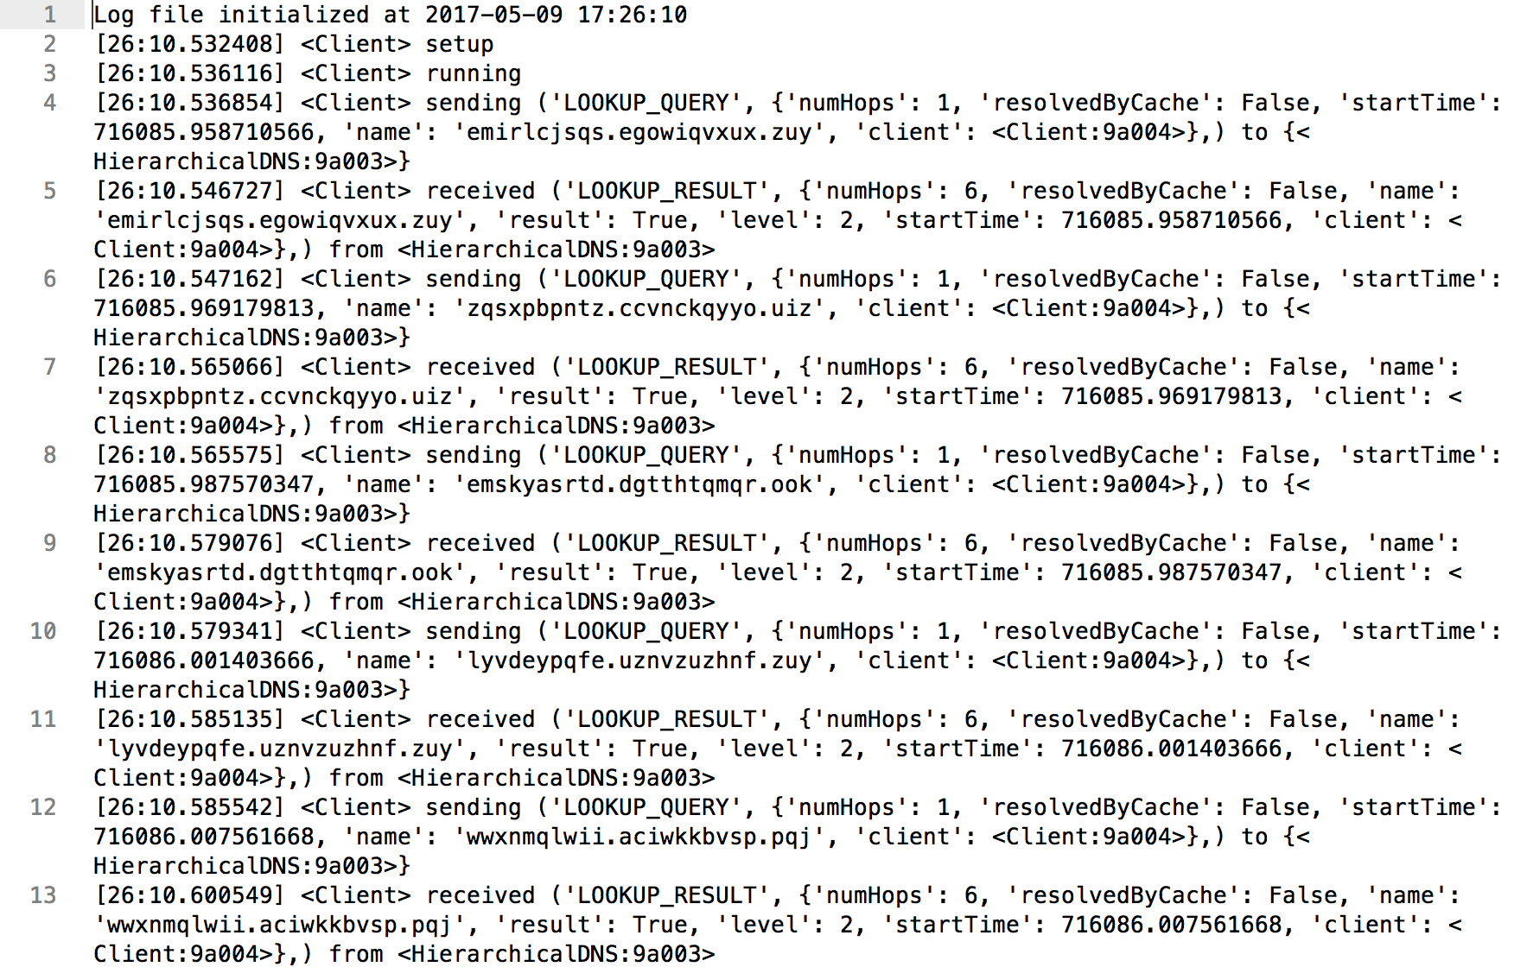
Client log file

Slide 10
Experiment 1
In this experiment, we measured the effect of increasing the depth of domain names. We increased the depth from 3 to 8 in step of 1. We were expecting that the latency for Hierarchy based DNS will increase as depth increases, while leaving the Chord based resolver unaffected.

Slide 11
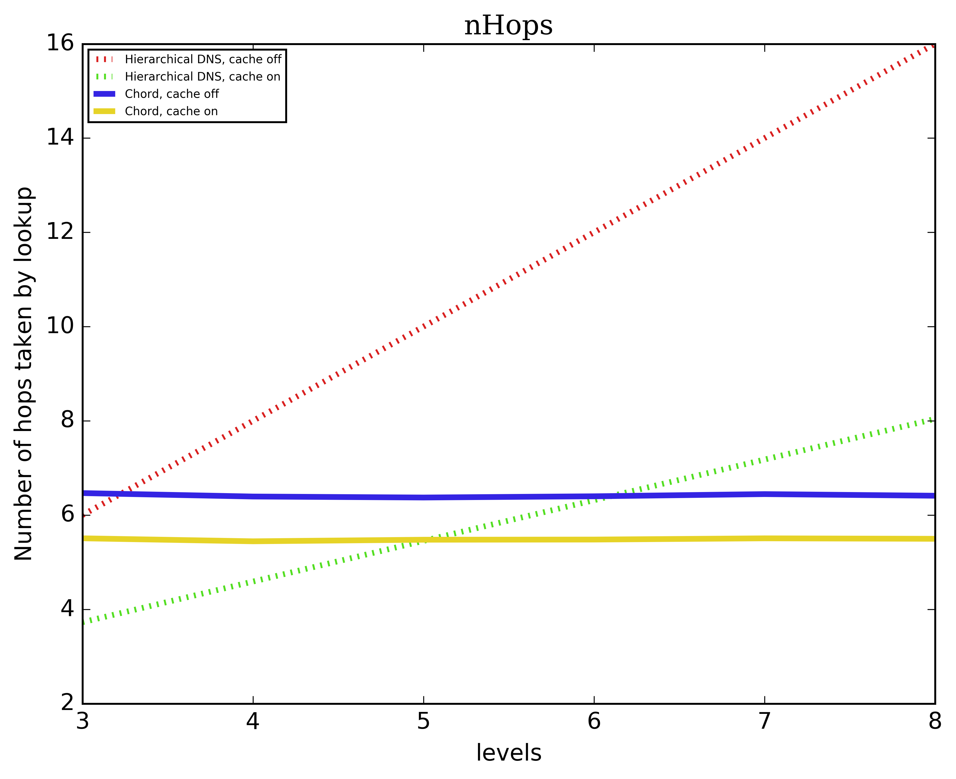

Slide 12
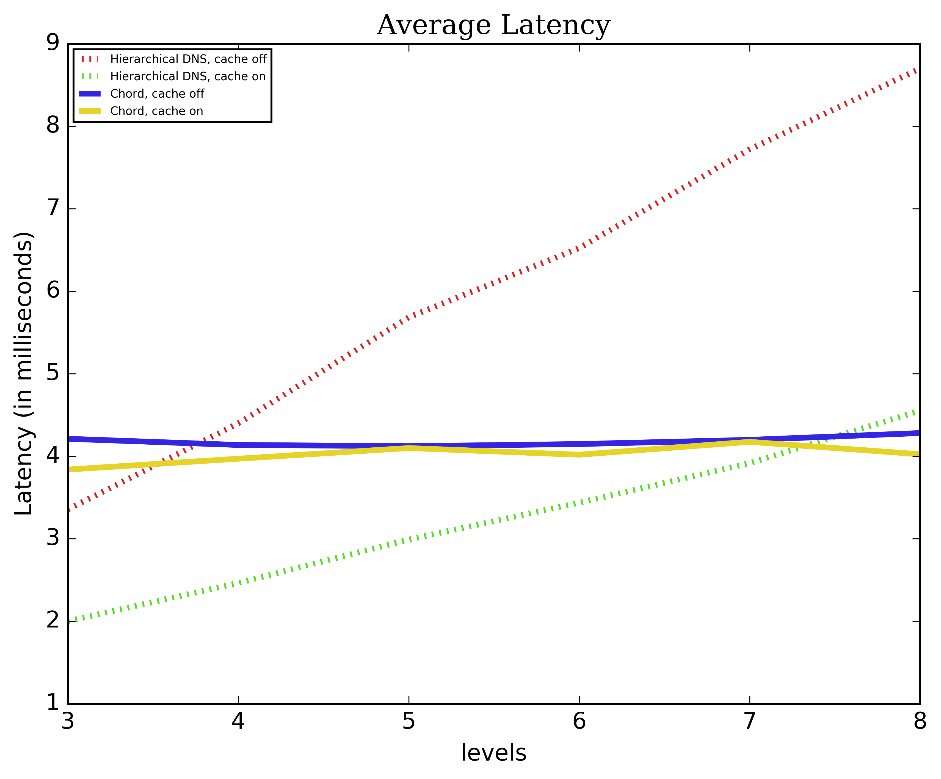

Slide 13
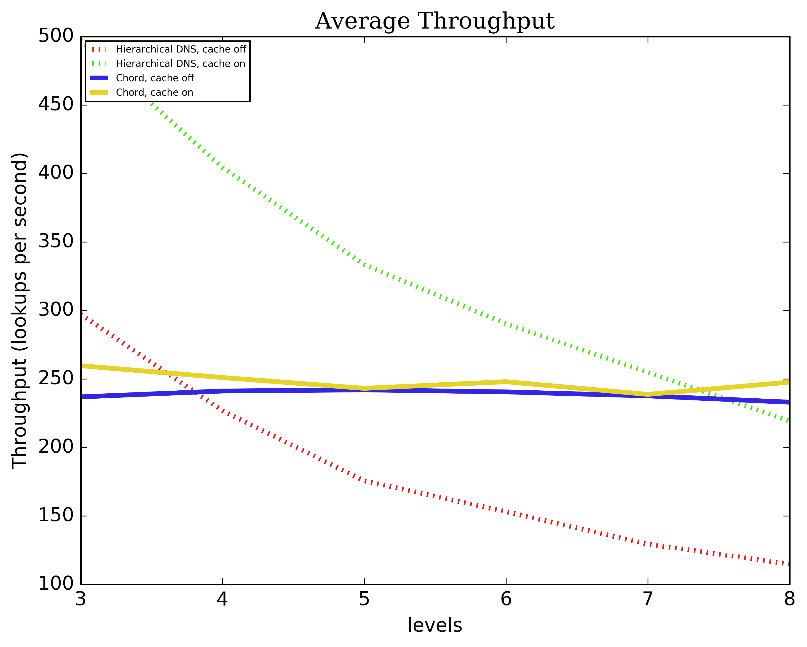

Slide 14
Experiment 2
In this experiment, we studied the effect of caching if some lookup requests are repeatedly queried. We implemented our own Least Recently Used(LRU) cache. The latency for both Chord based DNS and Hierarchical DNS resolver decreased as more and more requests come from a smaller subset of domain names.

Slide 15
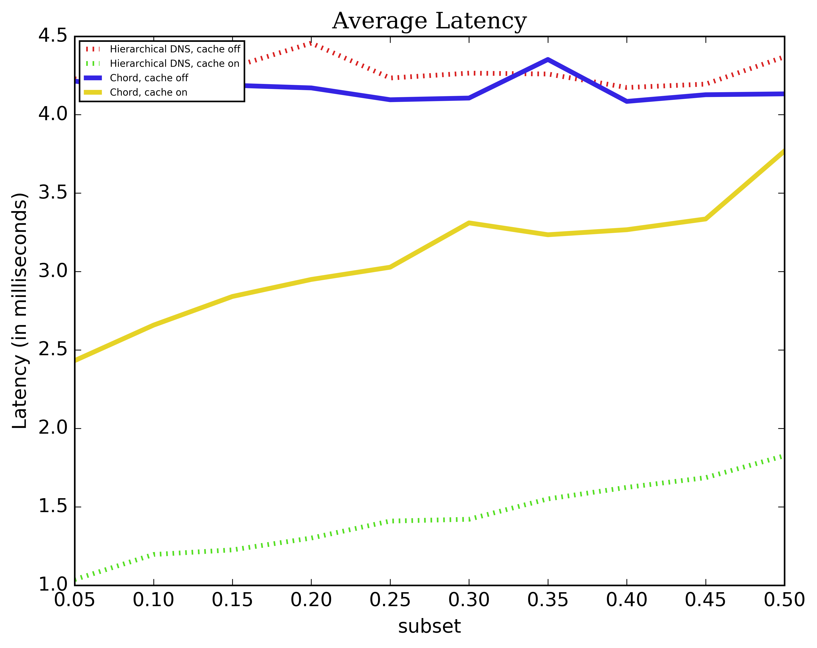

Slide 16
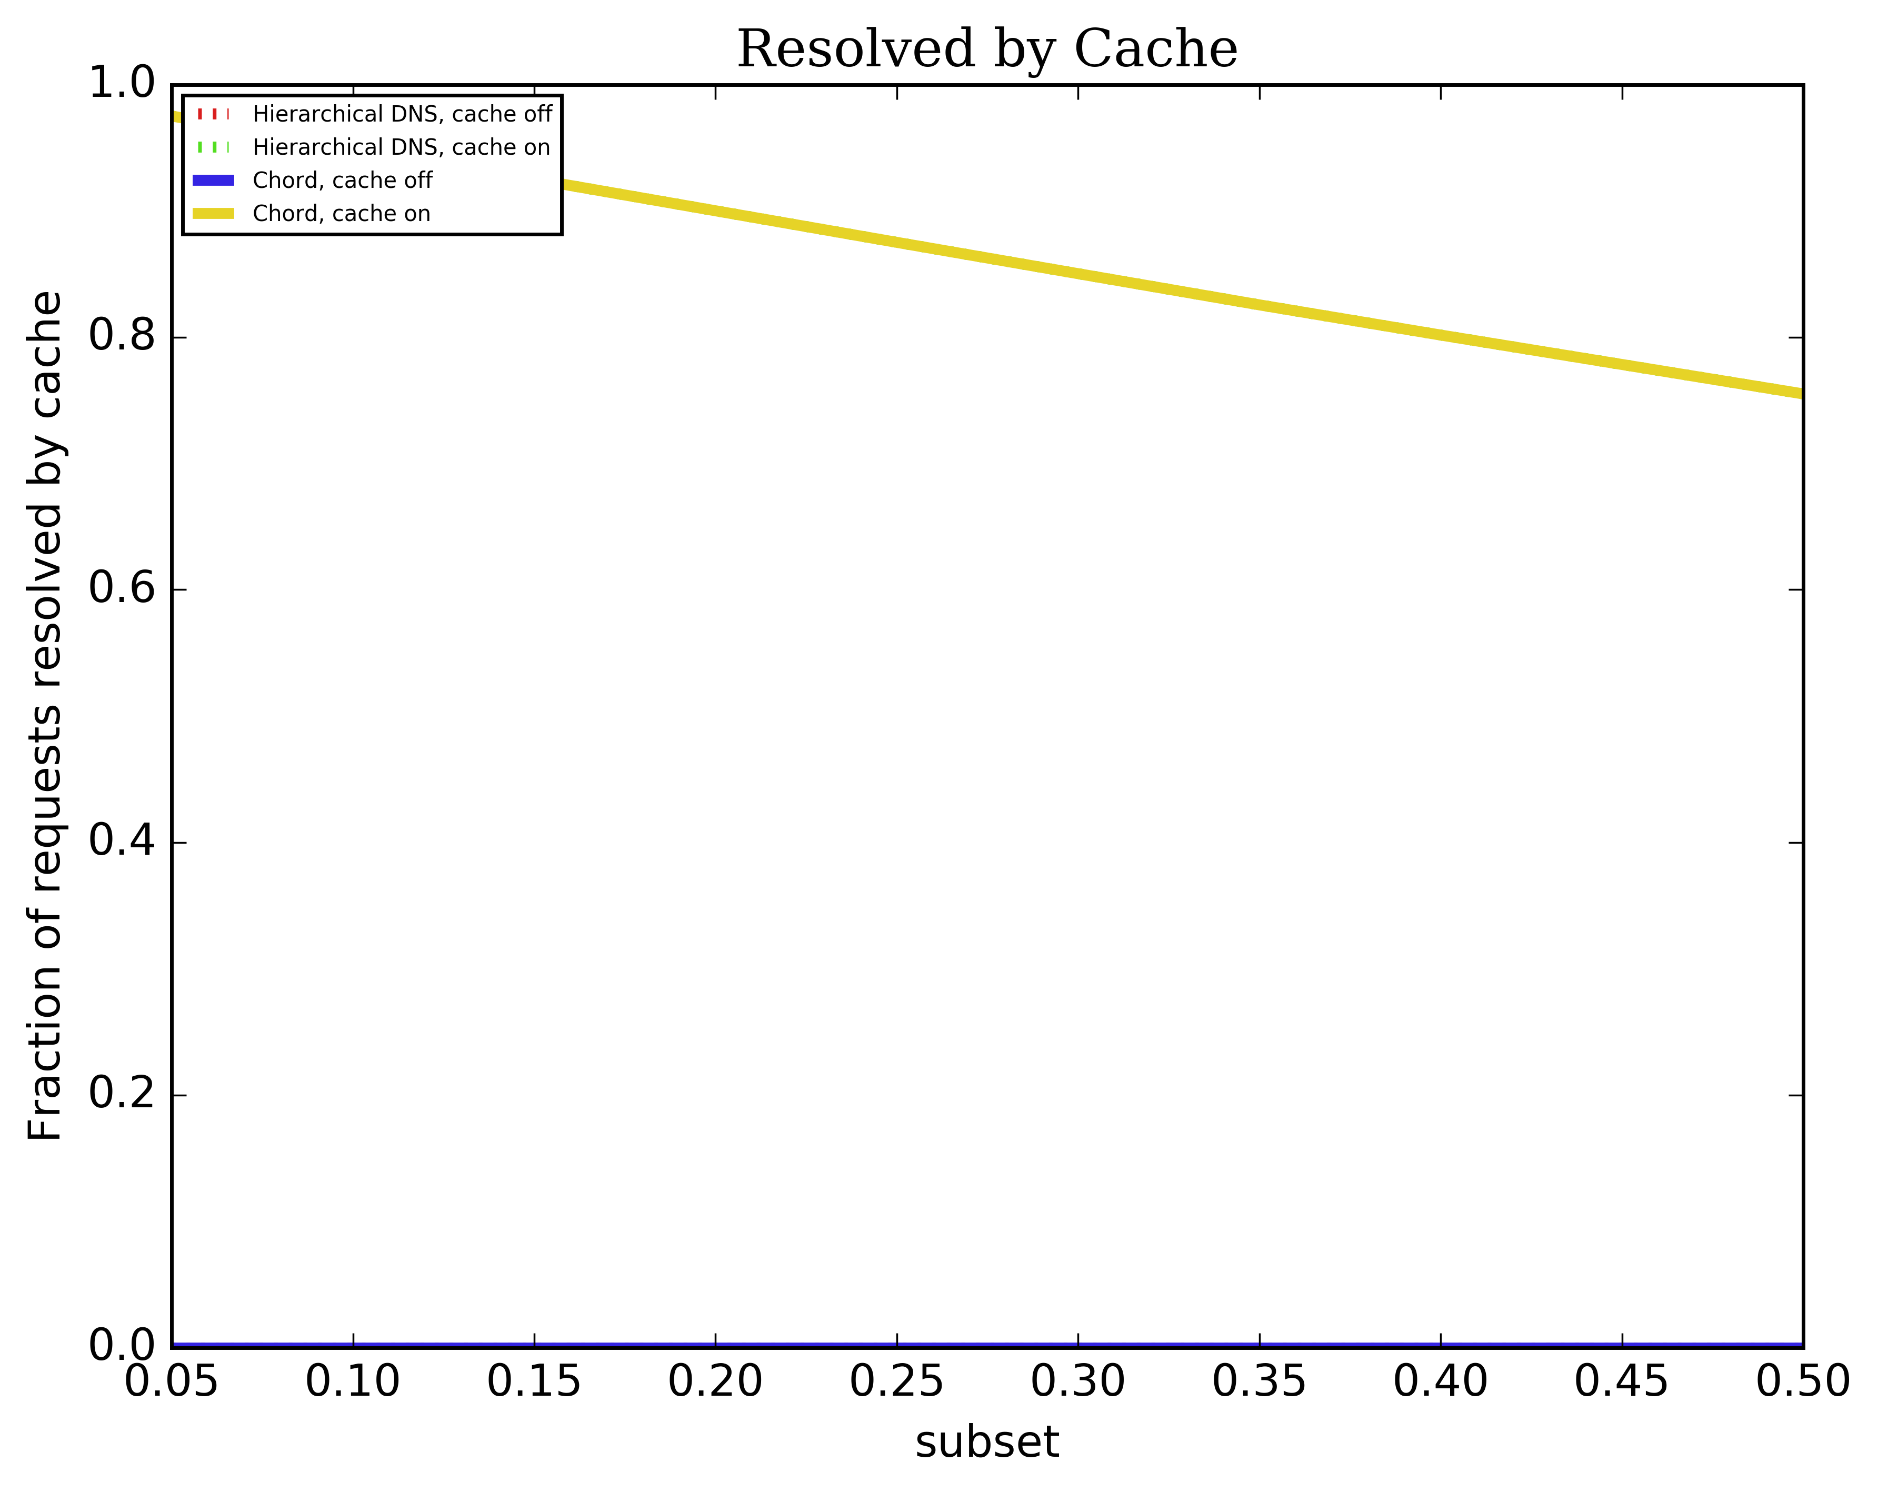

Slide 17
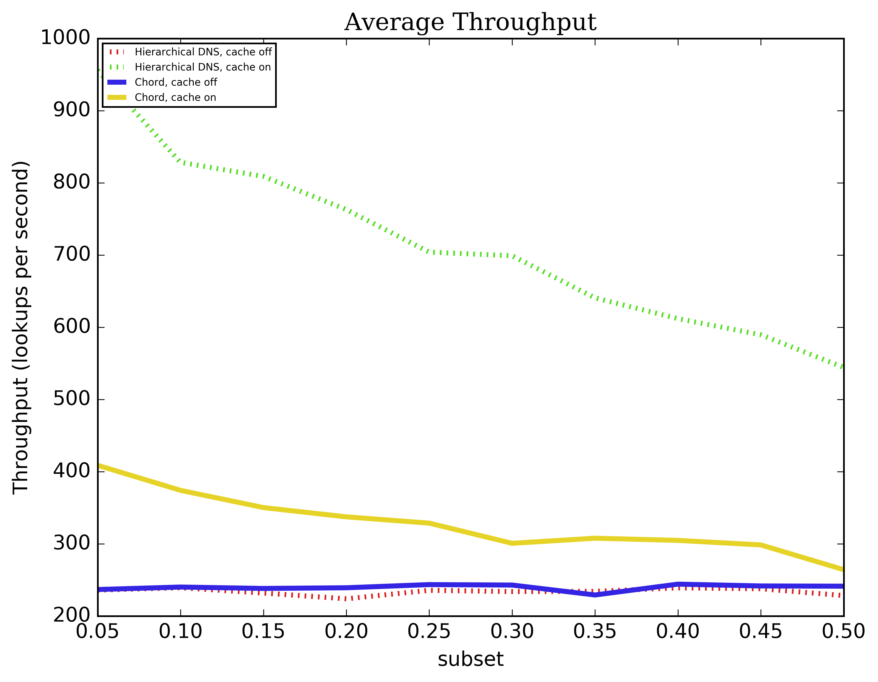

Slide 18
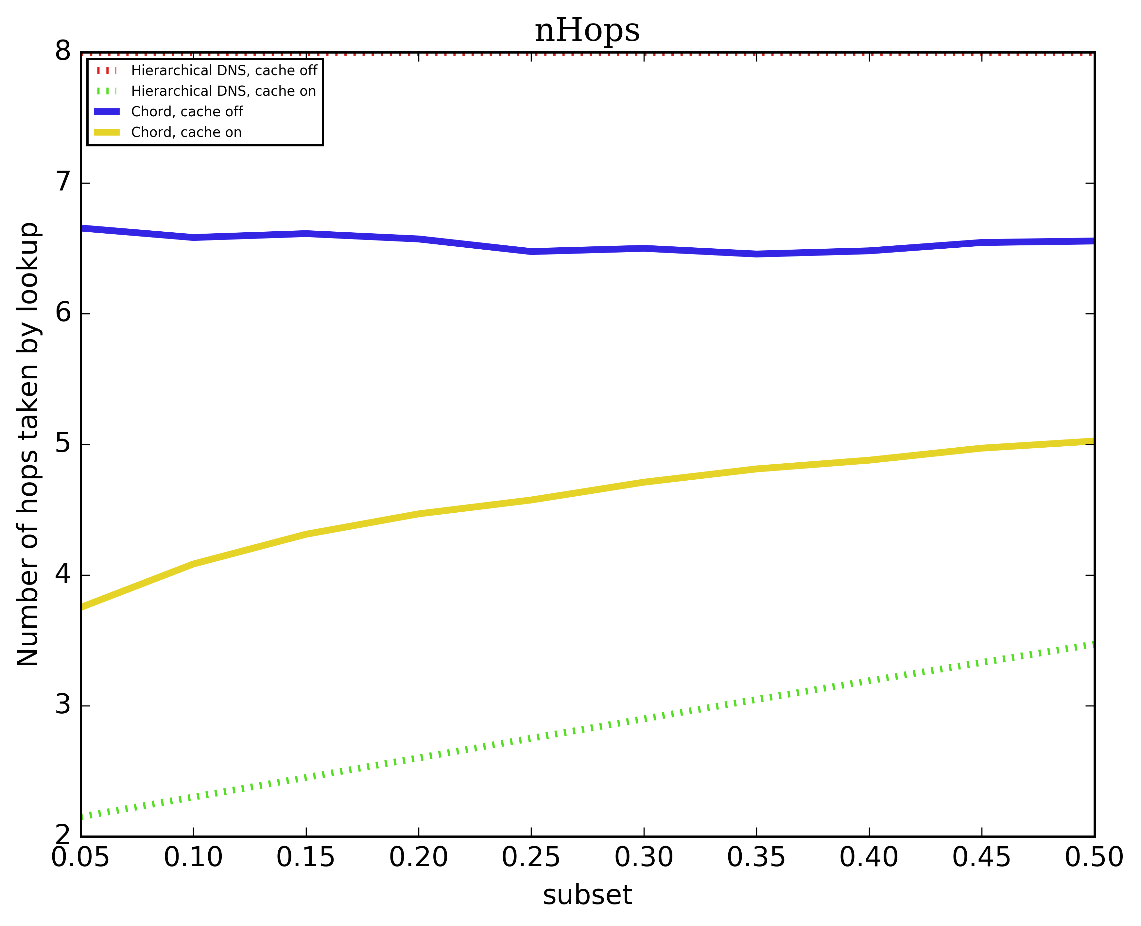

Slide 19
Experiment 3
In this experiment, we performed lookups for non-existent entries.
We generated queries that fail at a particular depth.
e.g. non-existent.google.com will fail at ‘non-existent’ in Hierarchical DNS, but will fail immediately in Chord based DNS.

Slide 20
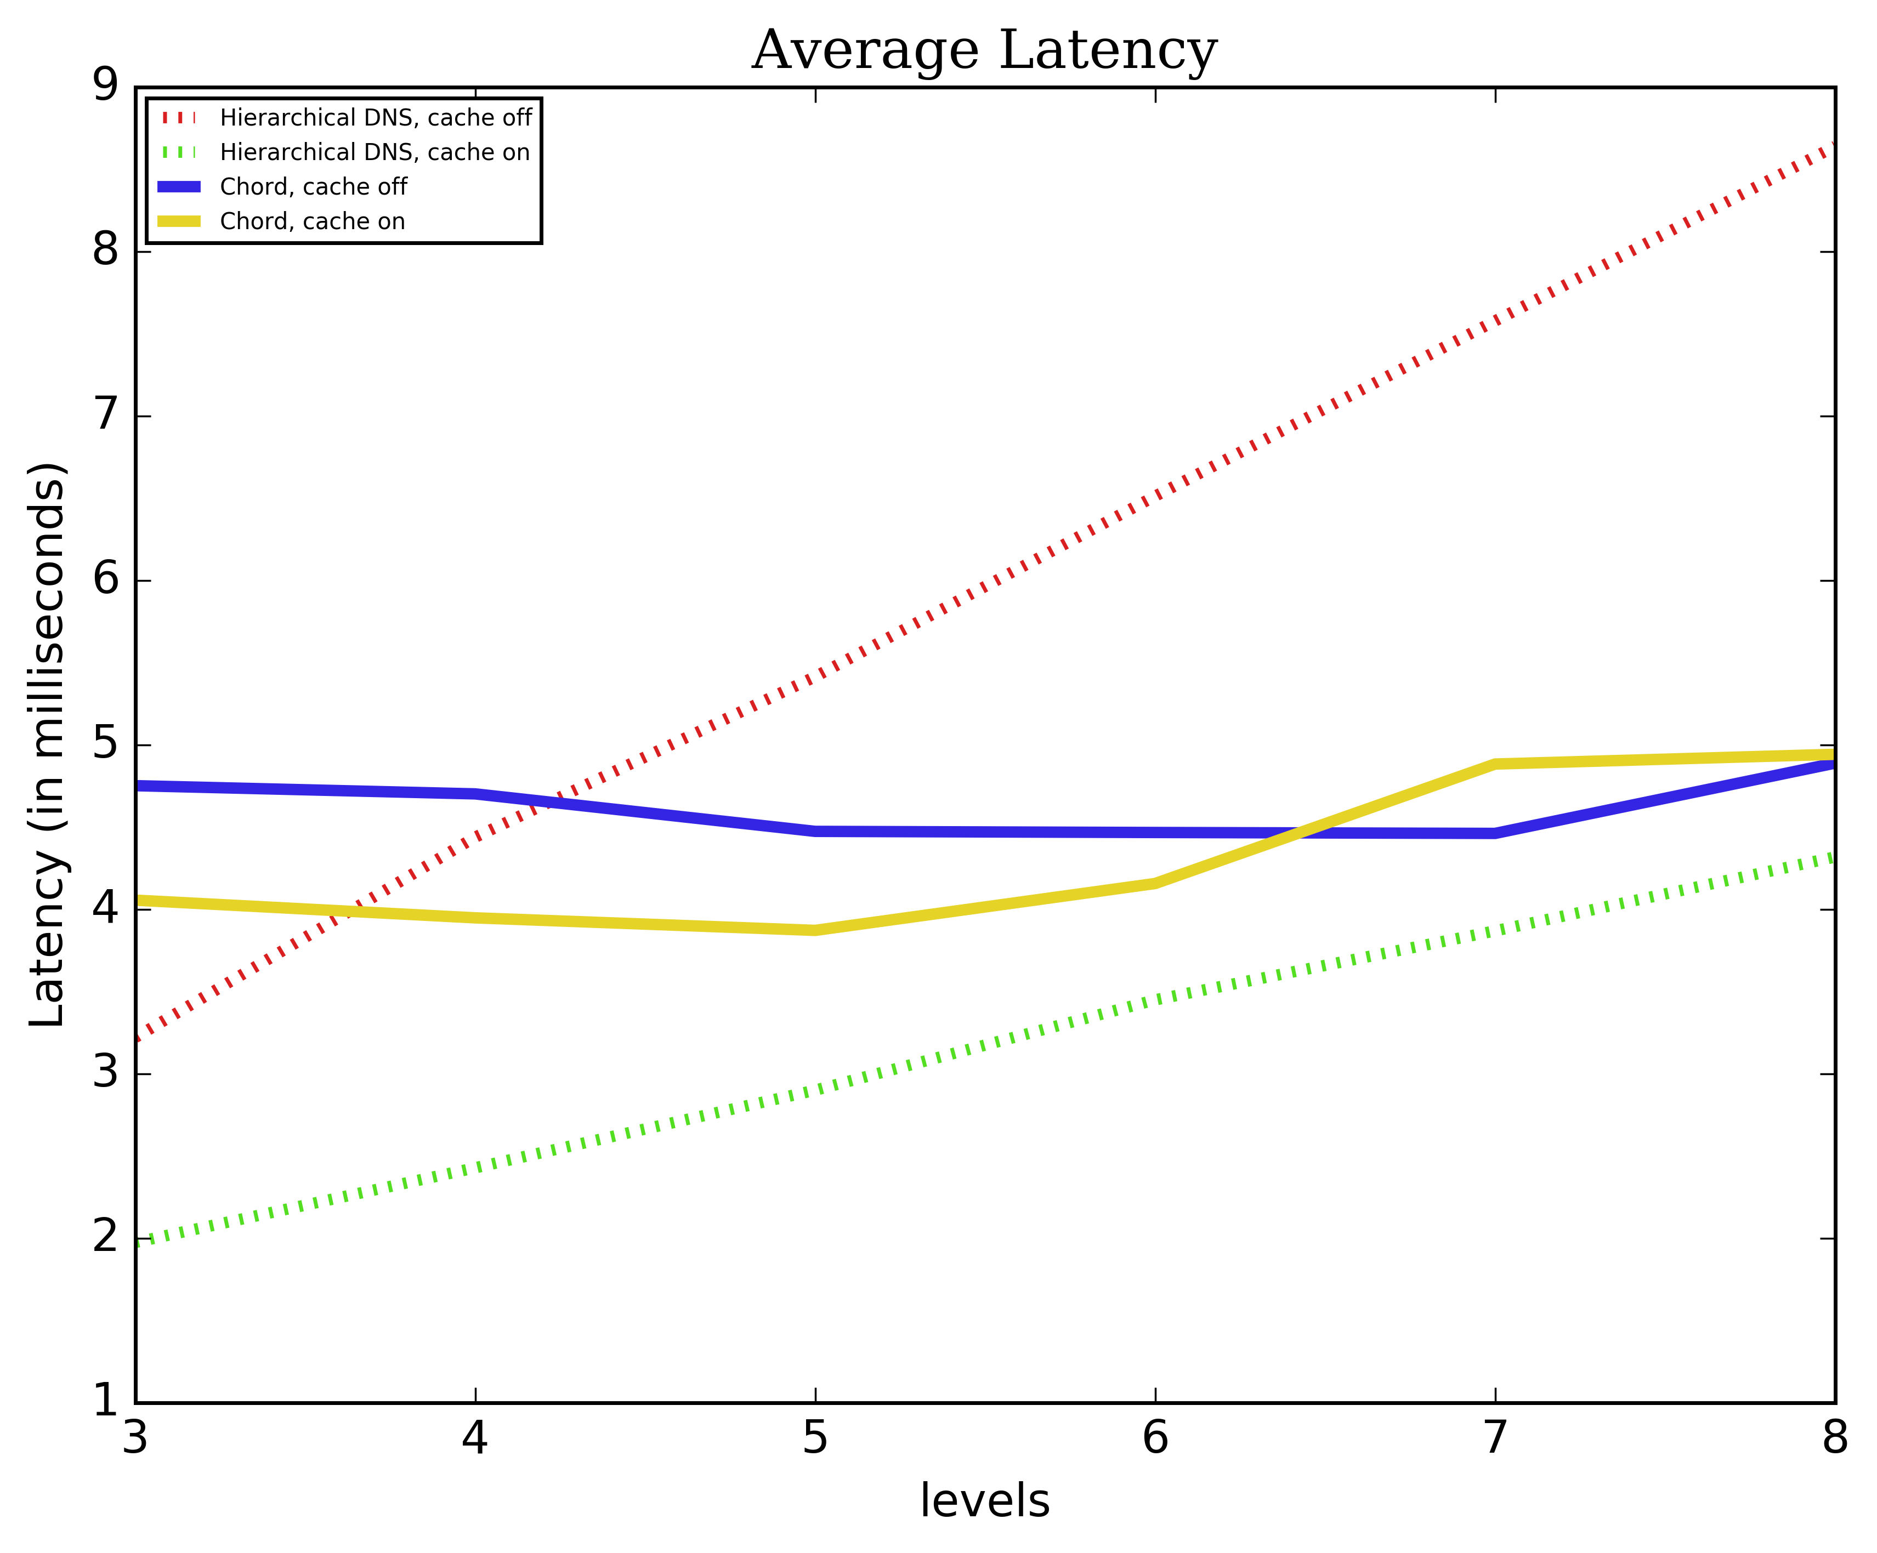

Slide 21
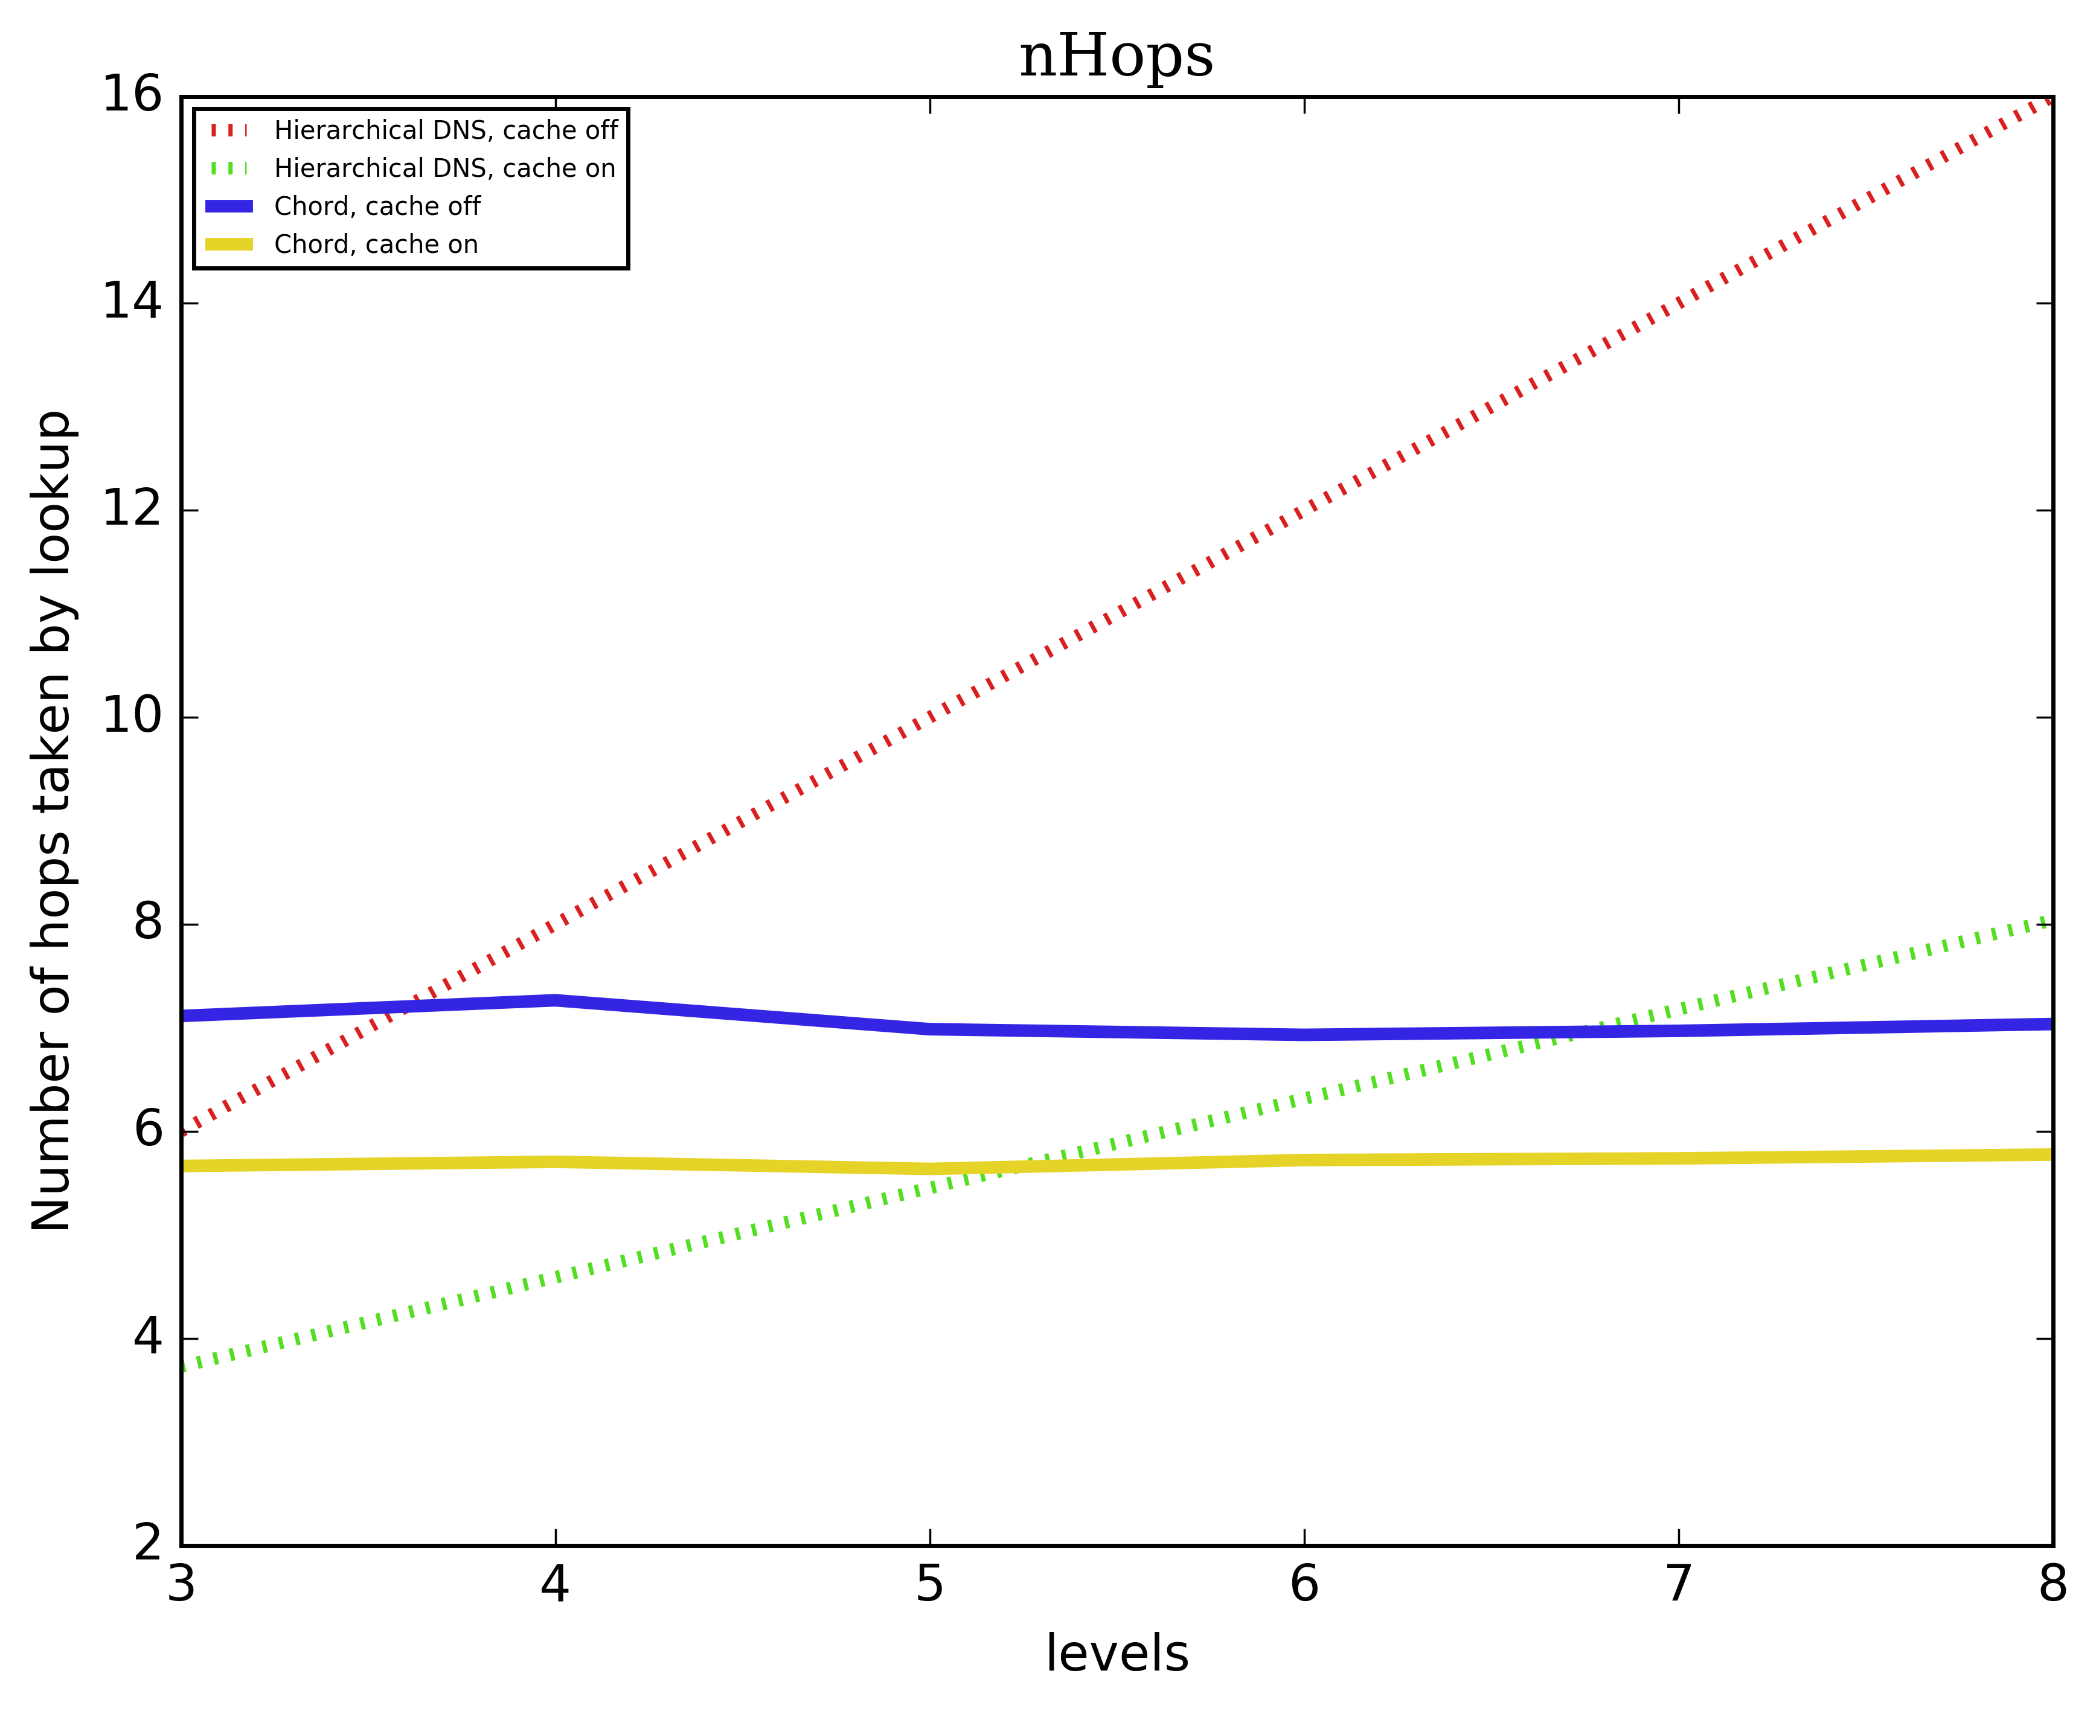

Slide 22
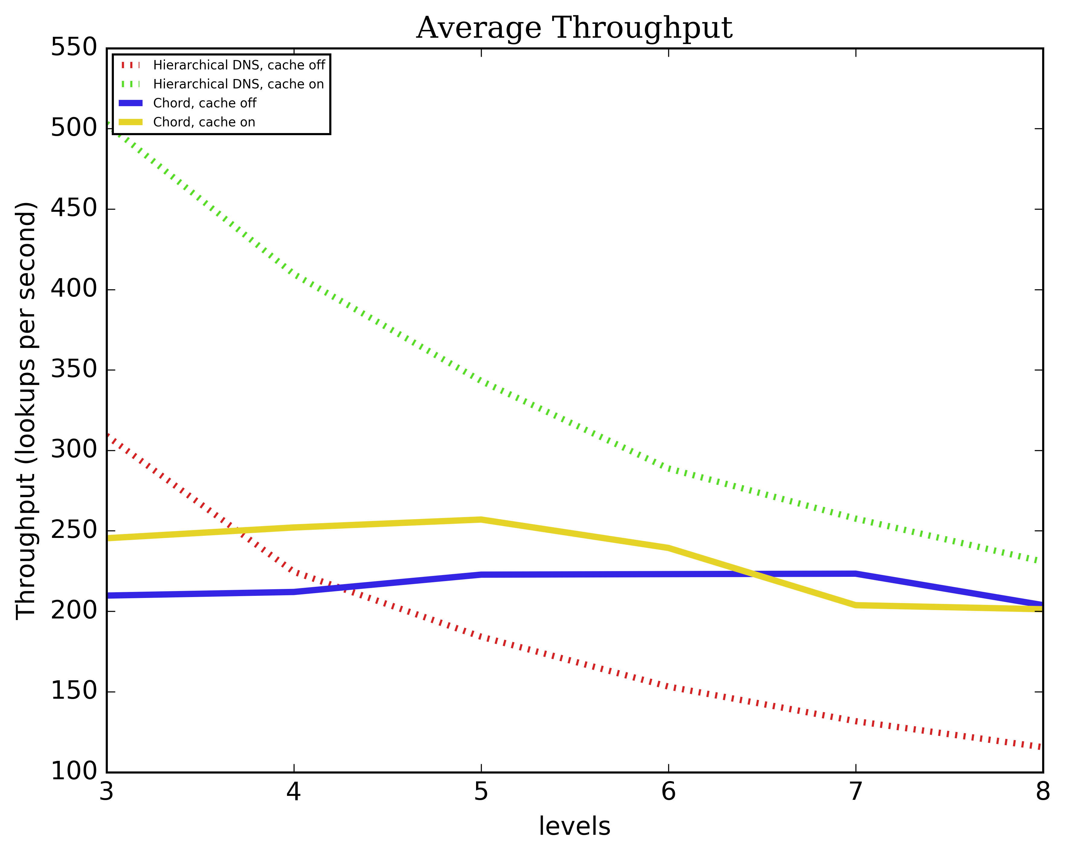

Slide 23
Experiment 4
In this experiment, we measured the effect of increasing the number of chord nodes on the latency of the responses. We will increase the chord nodes from 2 to 50 in step of 2. We noticed that the the latency for Chord based DNS resolver increases as the number of Chord nodes increases.

Slide 24
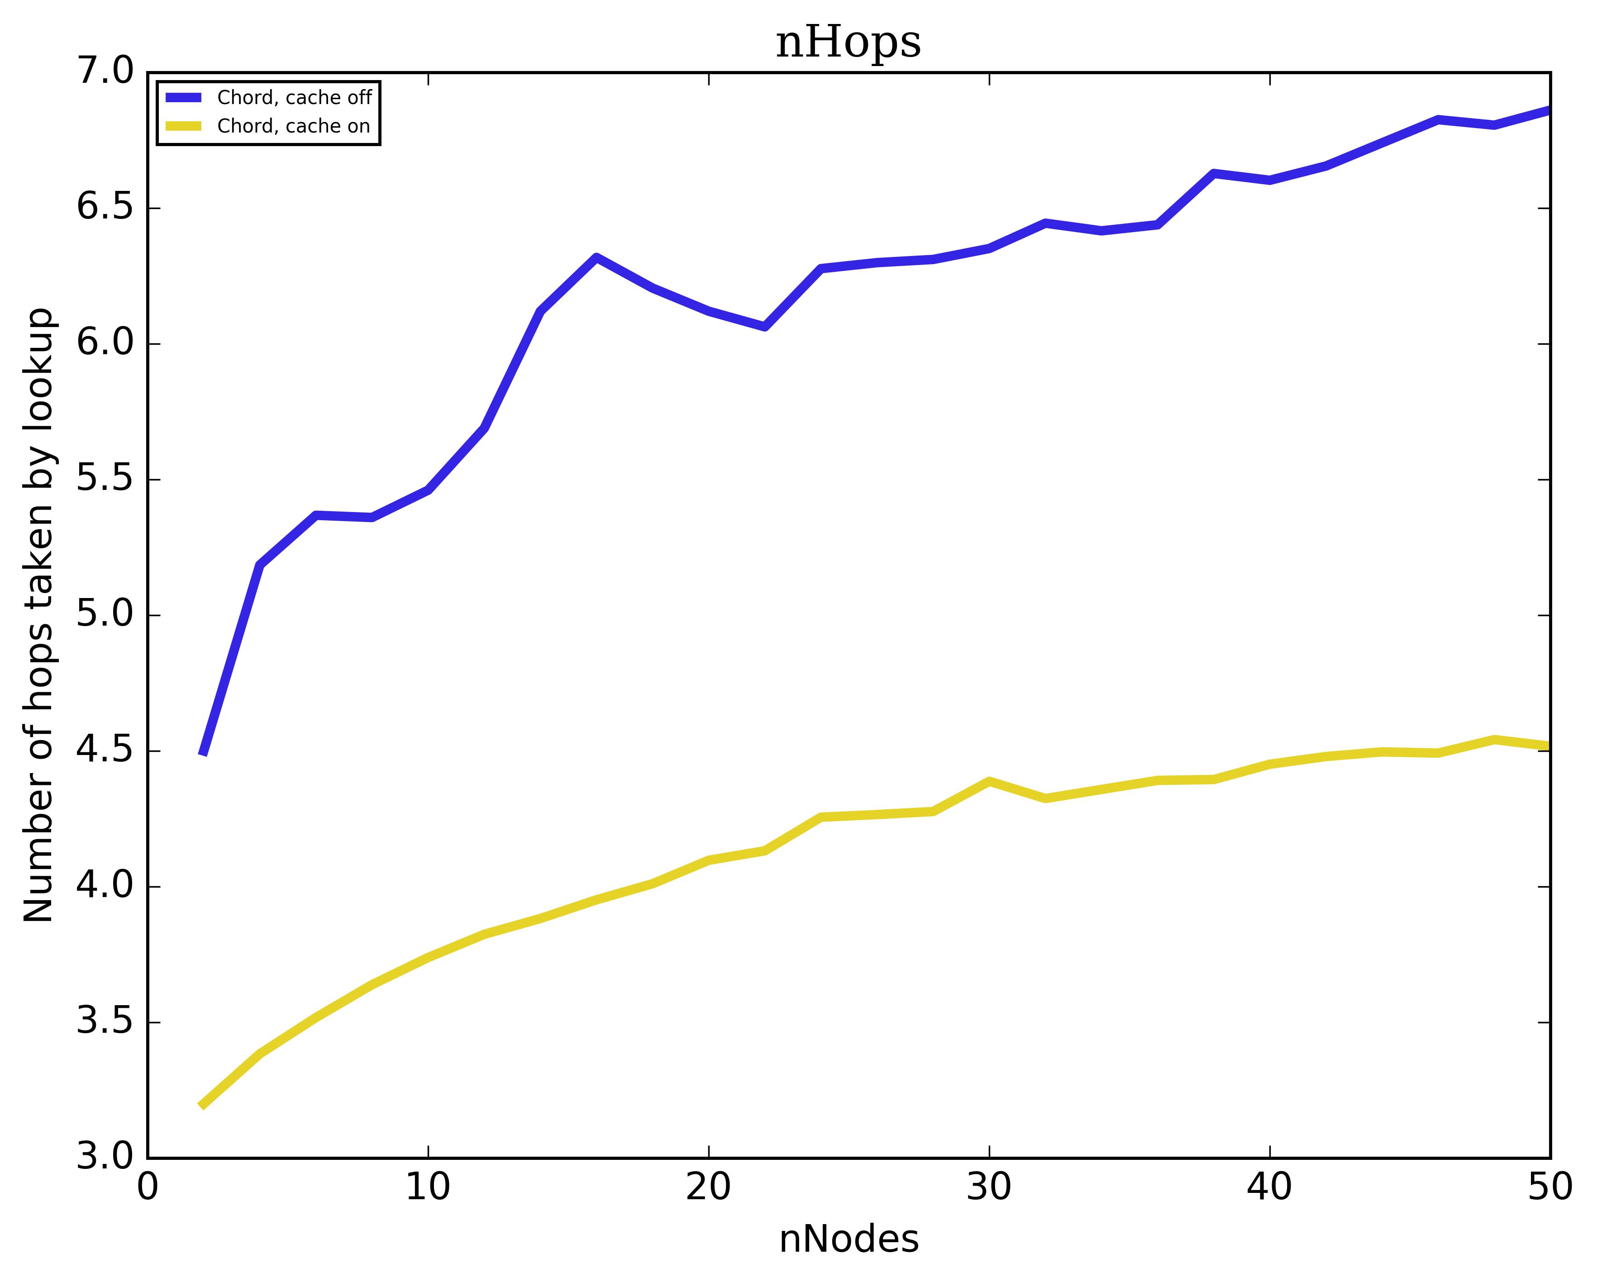

Slide 25
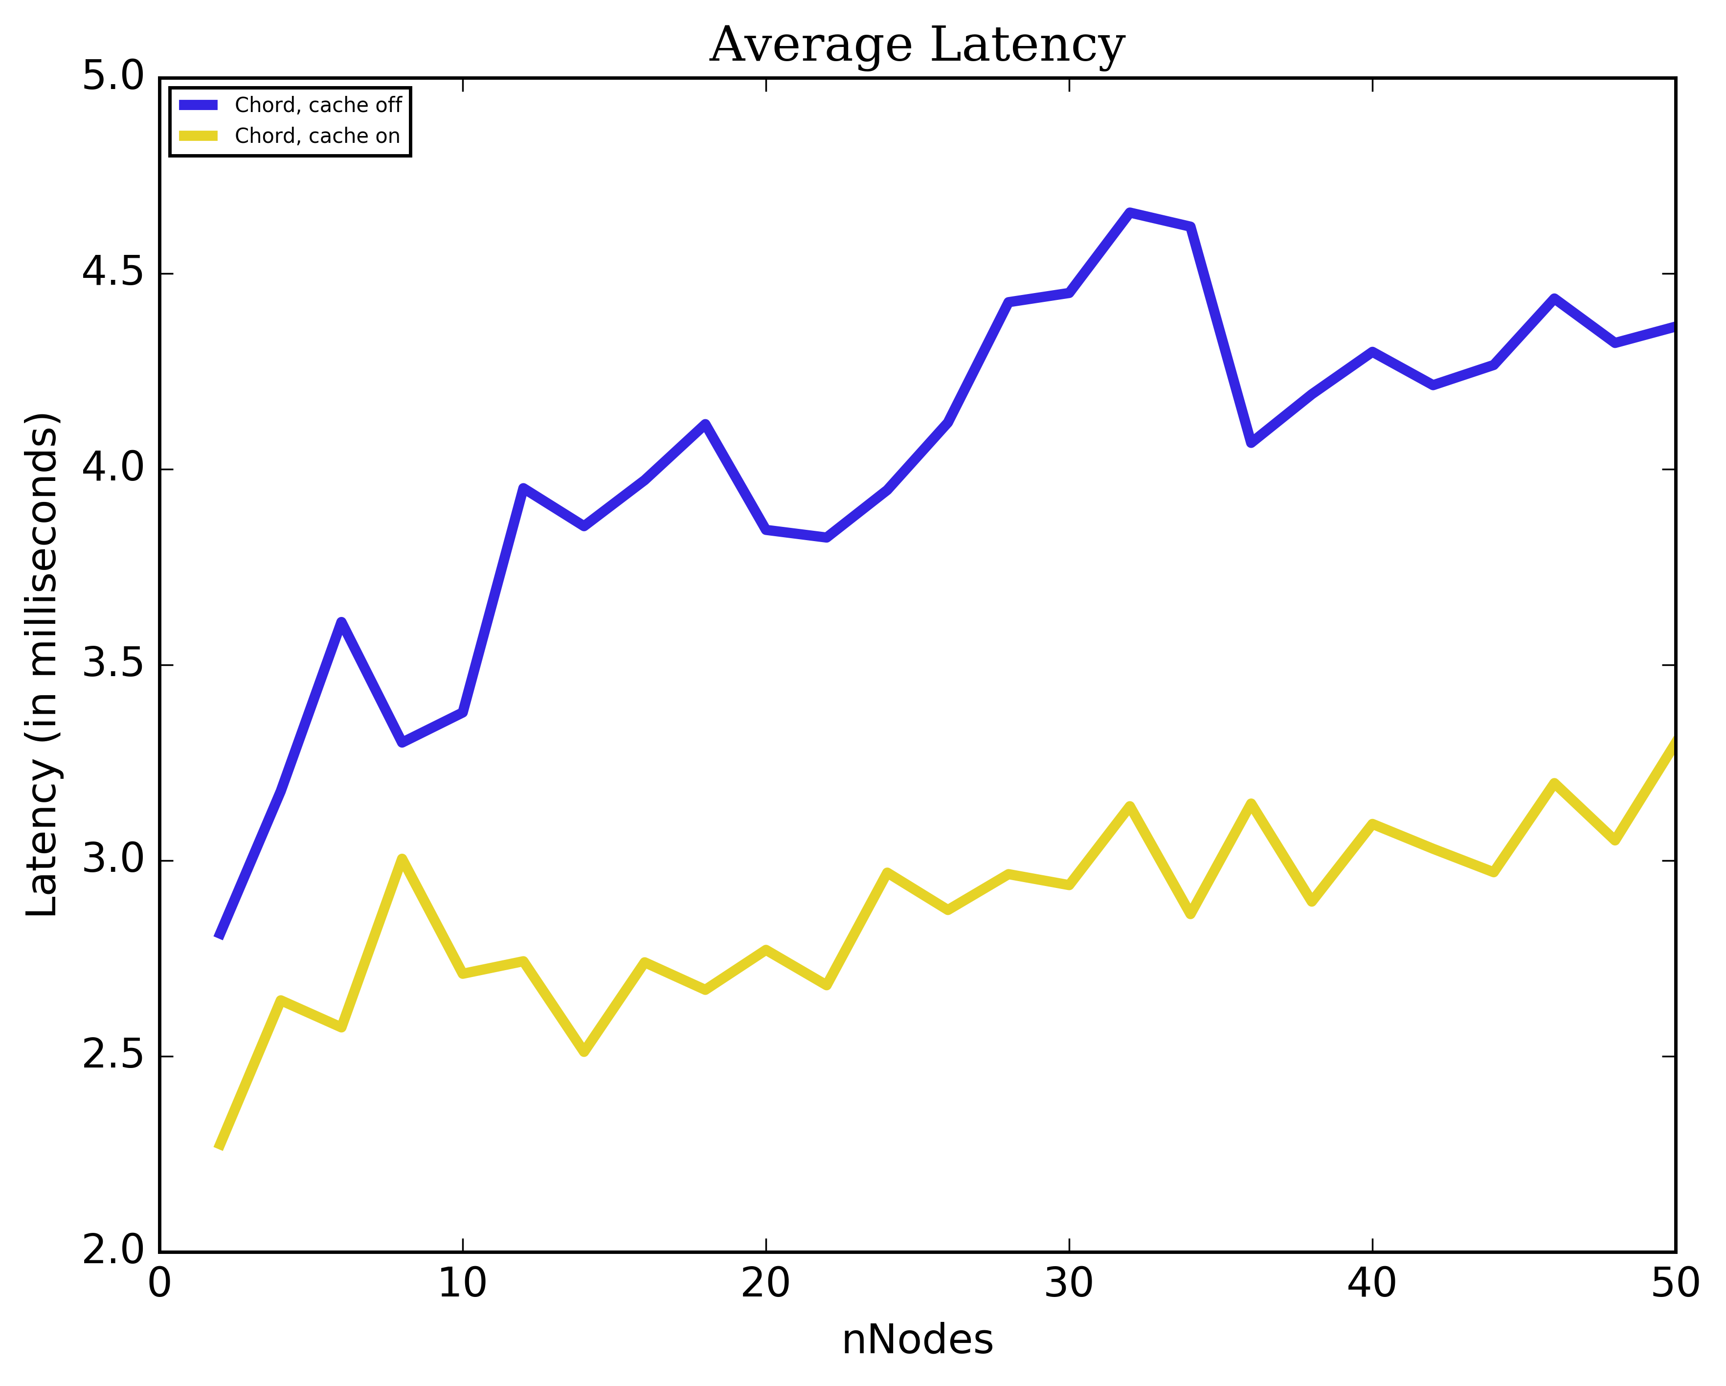

Slide 26
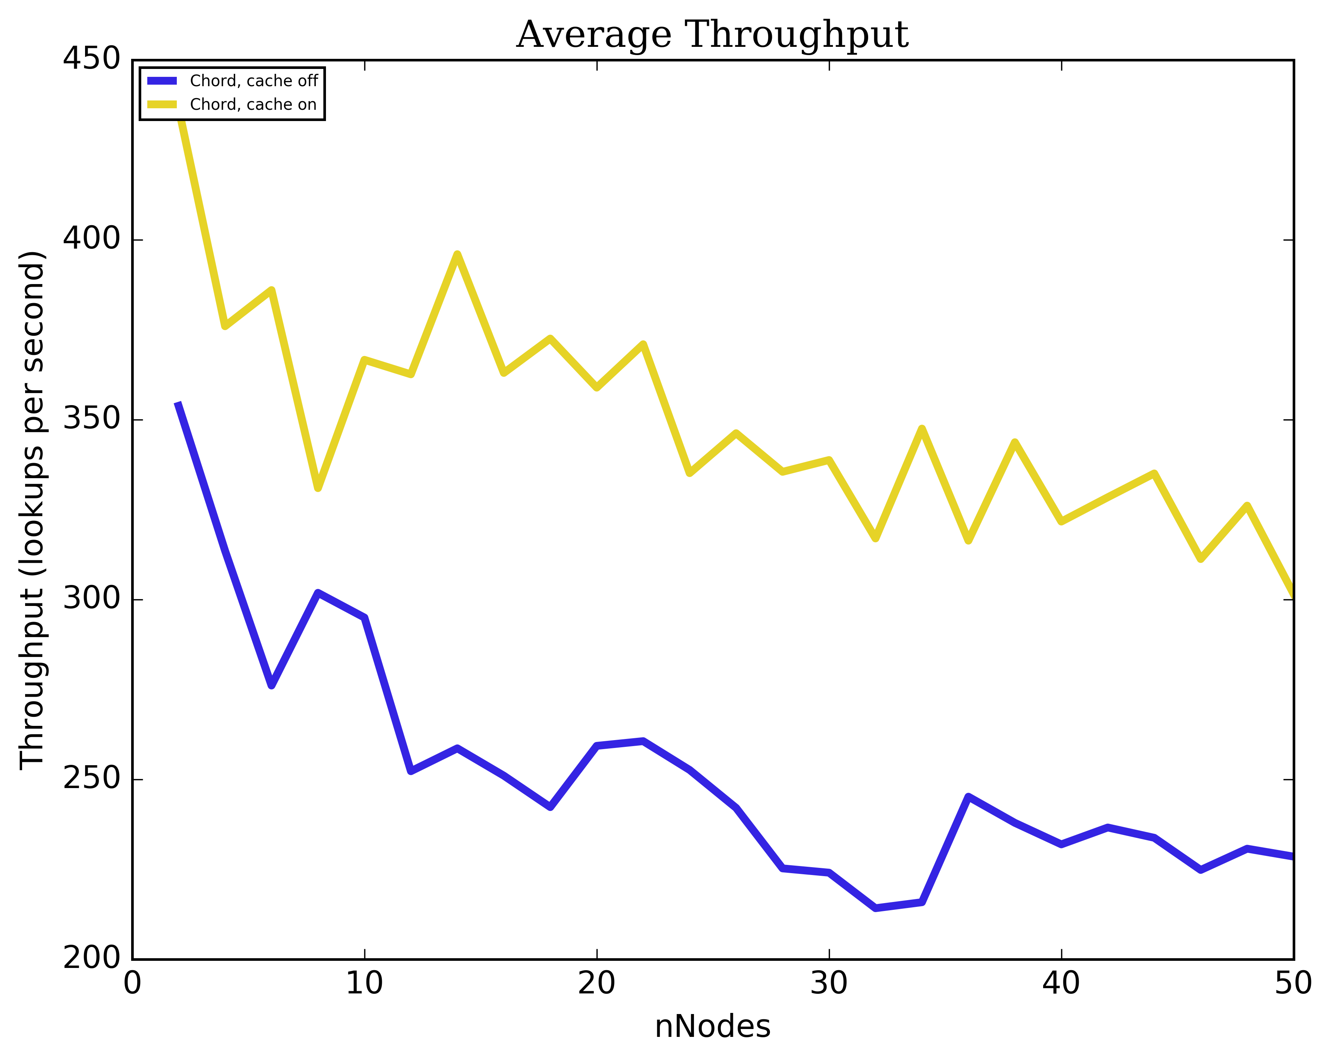

Slide 27
Conclusion
In our experiments, we found out that the performance of Hierarchical DNS( especially with caching) is better than Chord based DNS.
But the constant performance of Chord DNS suggests that it can be used in situations where the depth is very high.
It can also be used in cases where the total number of resources is small enough to justify the use of a short chord ring (with a small number of nodes) where the performance of Chord really shines.
Its use can also be justified in cases where the pros of using chord (fault tolerance, redundancy etc.) outweigh the cons (high latency).

Slide 28
Related work
Chord: A Scalable Peer-to-peer Lookup Service for Internet Applications, SIGCOMM01
Serving DNS using a Peer-to-Peer Lookup Service. Russ Cox et al.

